Slide 1

MICROSOFT EXCEL

Slide 2
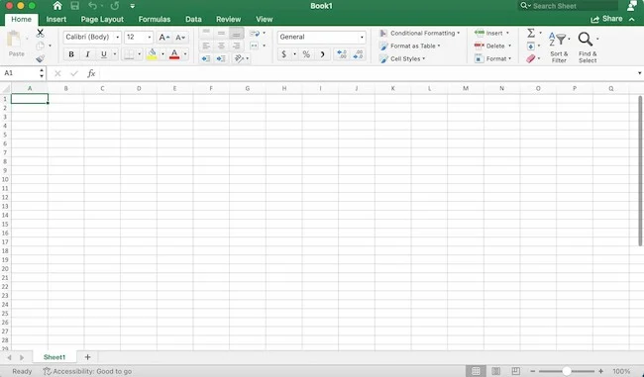
Microsoft Excel is a powerful spreadsheet program used for storing, organizing, analyzing, and visualizing data. It is widely used in businesses, schools, and personal finance management.

Slide 3
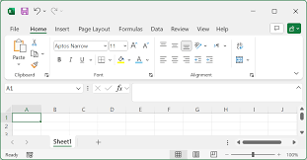
UNDERSTANDING ITS INTERFACE
When you open Microsoft Excel, you see:
A. Workbook and Worksheets
A Workbook is the Excel file where you work.
Each workbook contains multiple Worksheets (also called "Sheets").
Each worksheet is made up of a grid of cells.

Slide 4
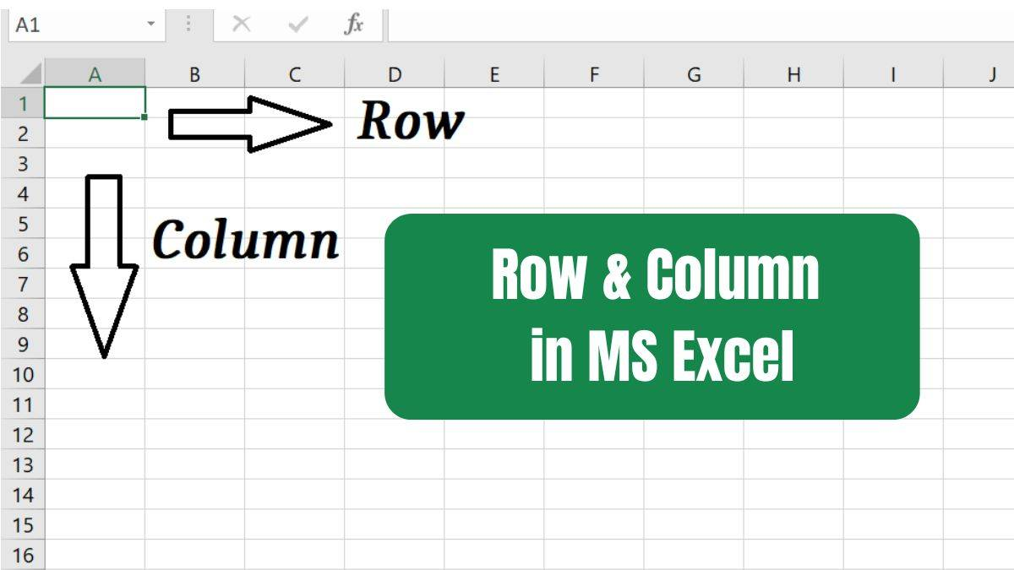
B. Rows, Columns, and Cells
Rows: Horizontal lines labeled with numbers (1, 2, 3, etc.)
Columns: Vertical lines labeled with letters (A, B, C, etc.)
Cells: The small boxes where you enter data (each cell has an address like A1, B2, C3).

Slide 5
Entering and Formatting Data
A. How to Enter Data
Click on a cell and start typing.
Press Enter to move to the next row or Tab to move to the next column.

Slide 6
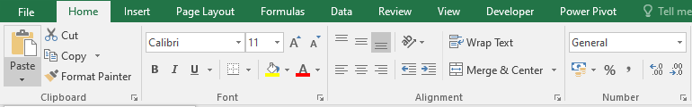
B. Formatting Data
Excel allows you to change how data looks:
Bold, Italics, Underline (from the toolbar).
Change Font, Size, and Color for better readability.
Merge Cells to combine multiple cells into one.
Wrap Text to keep text inside a cell without overflowing.
Number Formatting: Convert data into Currency ($), Percentage (%), Date, etc.

Slide 7
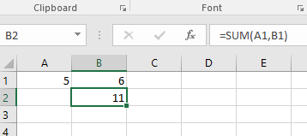
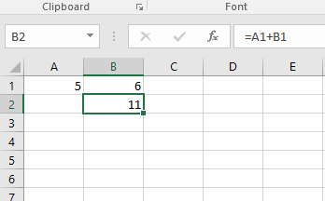
USING FORMULAS AND FUNCTIONS
What are Formulas?
Formulas perform mathematical calculations in Excel.
Every formula starts with = (equal sign).
Example: =A1 + B1 (Adds values in cells A1 and B1).

Slide 8
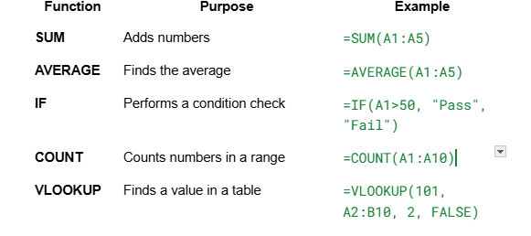

Slide 9
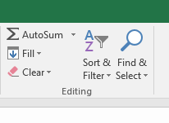
SORTING AND FILTERING DATA
A. Sorting Data
Select the data range.
Click Sort & Filter in the toolbar.
Choose Sort A-Z (ascending) or Sort Z-A (descending).
B. Filtering Data
Click on a column header.
Click Filter from the toolbar.
Use checkboxes to display only specific values.

Slide 10
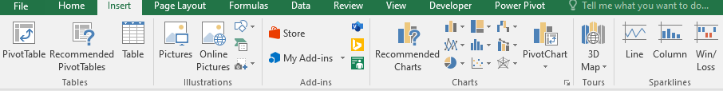
CREATING CHARTS
Excel allows you to visualize data using different charts.
How to Insert a Chart?
Select the data range.
Click Insert > Charts.
Choose a chart type:
Column Chart (for comparisons).
Pie Chart (for percentages).
Line Chart (for trends over time).

Slide 11
USING PIVOT TABLES
Pivot Tables are powerful tools to summarize and analyze large data sets.
How to Create a Pivot Table?
Select the data range.
Click Insert > PivotTable.
Drag and drop fields to Rows, Columns, Values, and Filters to analyze data.

Slide 12
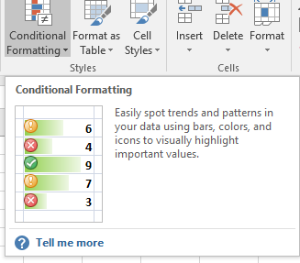
CONDITIONAL FORMATTING
Conditional Formatting highlights cells based on specific conditions.
How to Apply Conditional Formatting?
Select the data range.
Click Home > Conditional Formatting.
Choose a rule (e.g., highlight cells greater than 50).

Slide 13
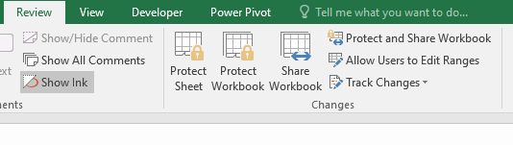
PROTECTING AND SECURING DATA
Lock Cells: Prevent others from changing important data.
Protect Sheets: Click Review > Protect Sheet to restrict editing.
Password-Protect a Workbook: Click File > Info > Protect Workbook.

Slide 14
SAVING AND EXPORTING FILES
Excel allows you to save and export your files in different formats:
Save as Excel file (.xlsx) for regular use.
Save as PDF (.pdf) for easy sharing.
Export as CSV (.csv) for raw data processing.

